Slide 1

SHINING COMMUNITIES CBO
The
Advocacy Network for Development

Slide 2
THRUST
Give voice to communities with a view to reducing the marginalization gap

Slide 3

OUR PILLARS

Slide 4
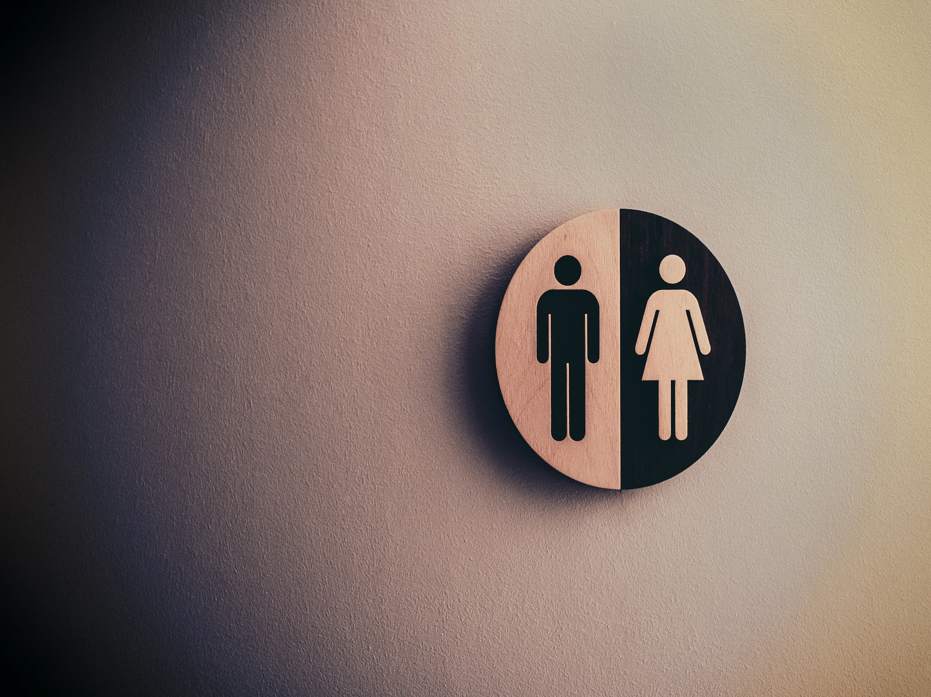
Gender Advocacy

Slide 5
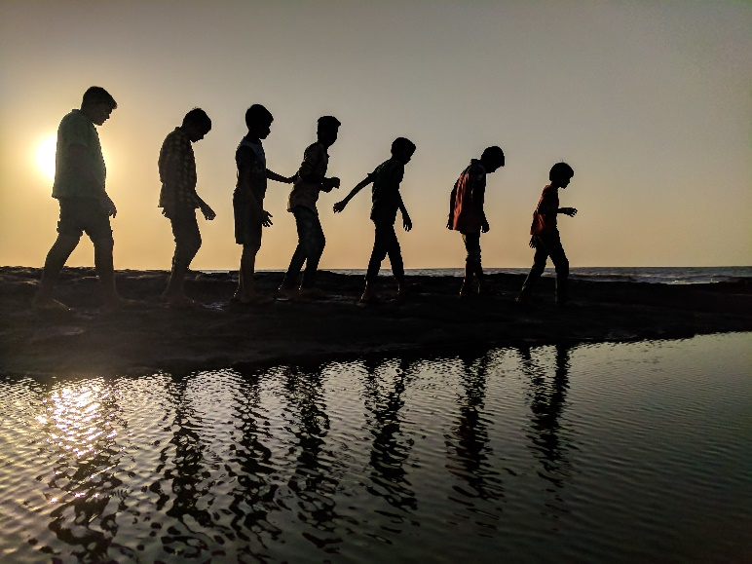
Children and Youth Advocacy

Slide 6
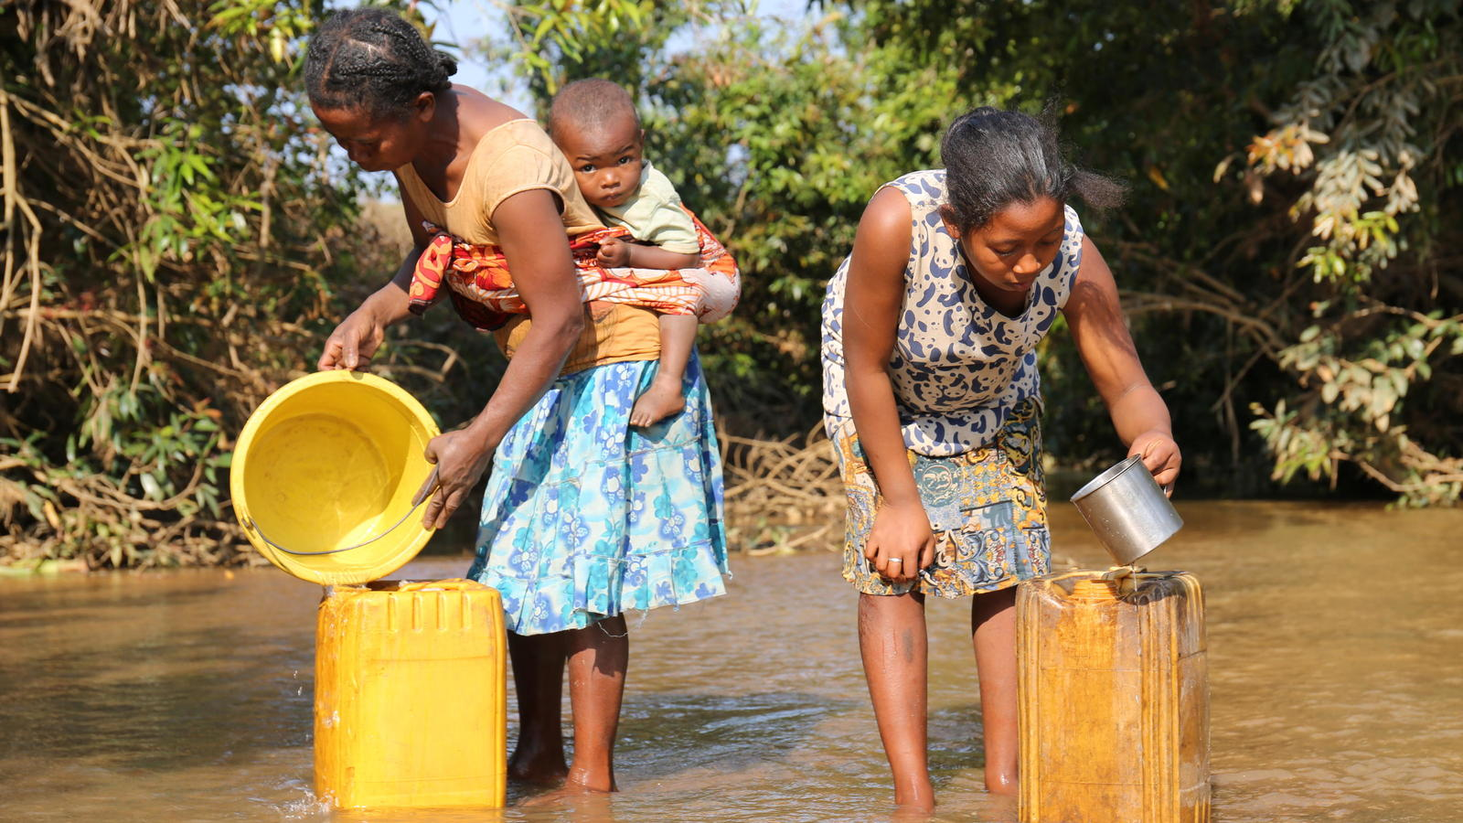
Water Rights and Environment Advocacy

Slide 7

Business & Global Trade Advocacy

Slide 8
MEANS
Review trends to establish where the debate is (Baselines)
Establish what needs to be done/gaps
Identify Action Platforms that exist
Generate a body of knowledge to create awareness among actors and build rationale for action.
Collate information collected into:
    Papers
    Publicaitions
    Newletters
    Posters
Disseminate in:
    Seminars
    Worksops
    International meetings
    Conferences
    Website

Slide 9
GENDER ADVOCACY
Women and Leadership
Economic Empowerment
Gender Based Violence
Etc

Slide 10
CHILDREN AND YOUTH ADVOCACY
Street Children
Female Genital Mutilation
Teenage Pregnancies
Etc

Slide 11
WATER AND SANITATION RIGHTS ADVOCACY
Access
Governance (representation)
Participation
Etc

Slide 12
BUSINESS &GLOBAL TRADE ADVOCACY
Small Business Development and Empowerment
Market Access
North South Divide
Trade Barriers (Tariff and non-tariff)
Etc

Slide 13
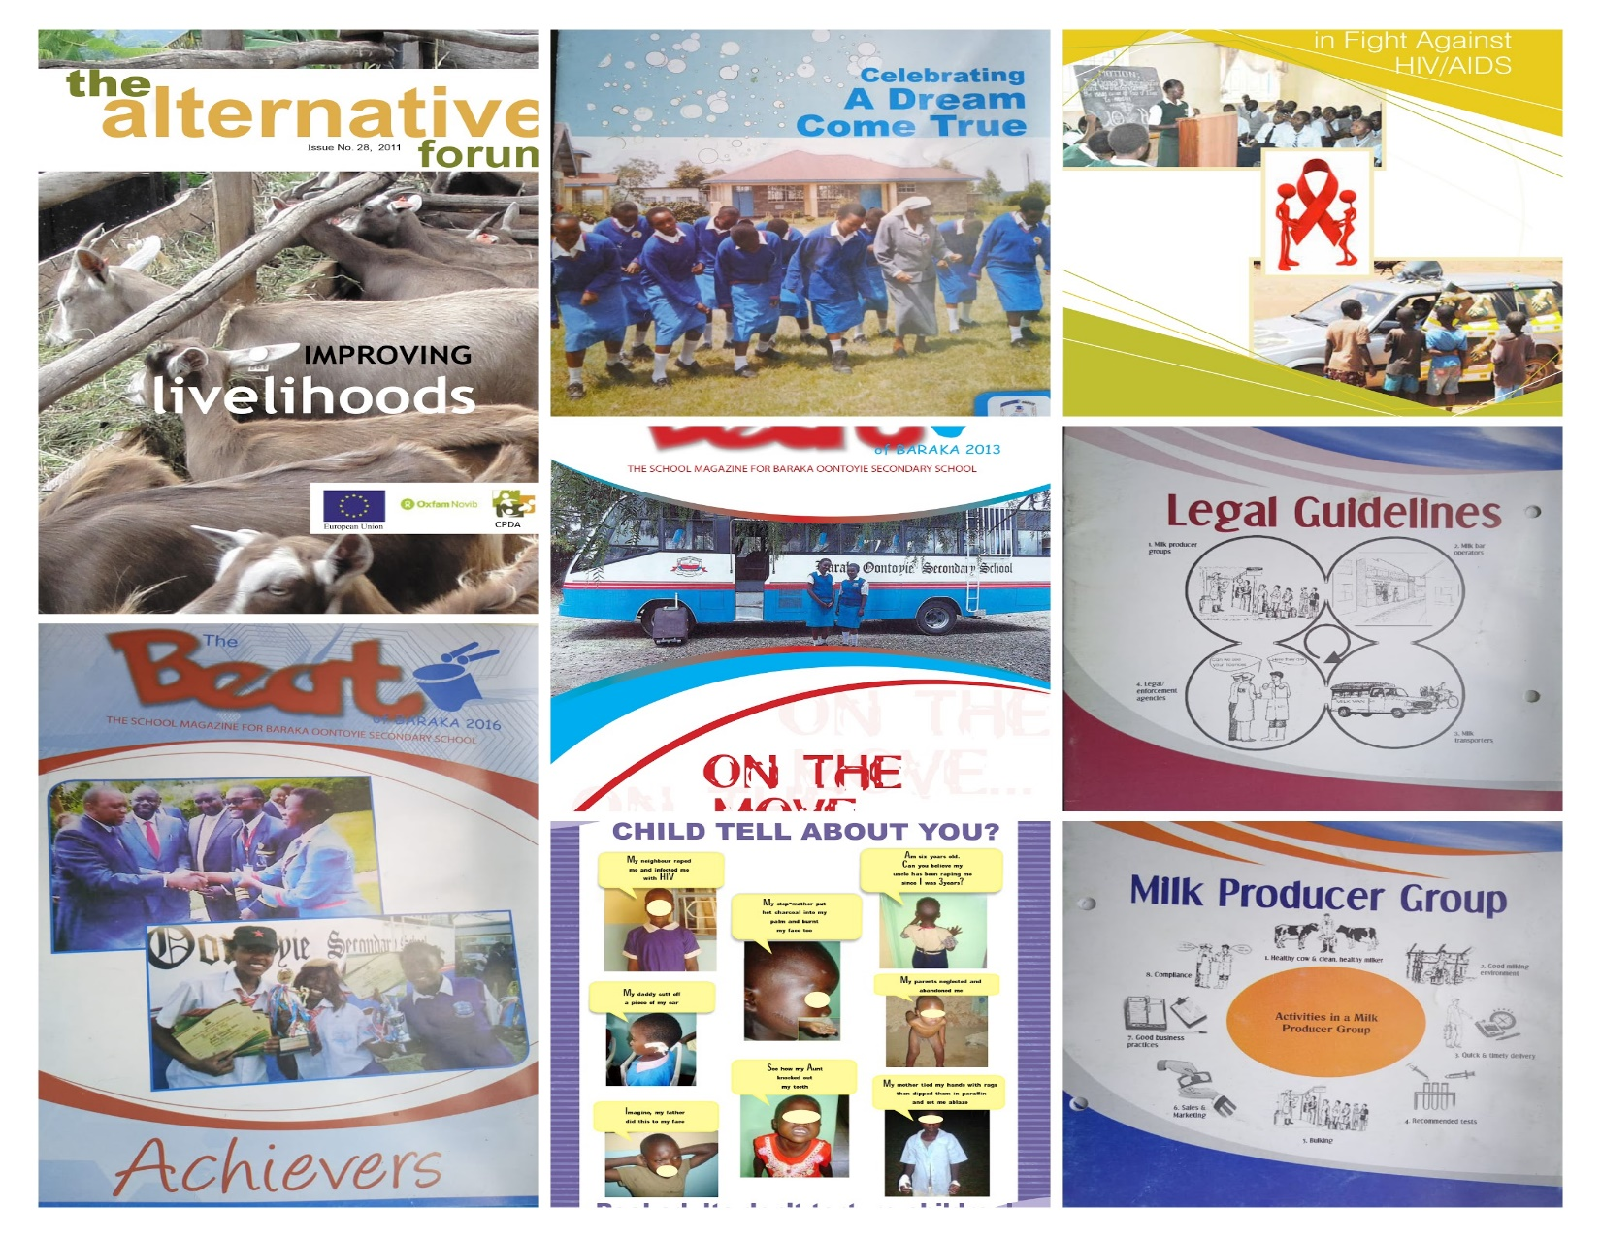
SOME OF OUR PAST WORKS

Slide 14
PARTNERSHIP
Support a paper on a topical issue
Support dissemination of topical paper in designated forum)
Support other information collection (body of knowledge initiative)
Support a newsletter or publication
Support another awareness initiative (website, participation for capacity etc)
Use our Master Rapporteur Programme
Let us develop your Communications Strategy

Slide 15
-ENDS-

